Slide 1
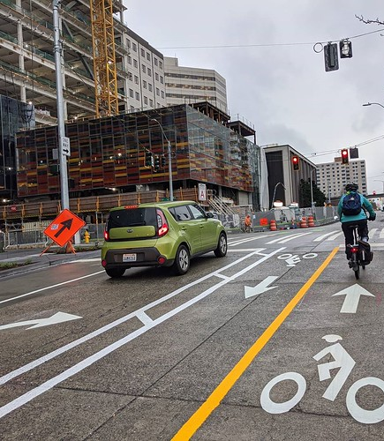
Innovations in Transportation to Enhance Safety and Efficiency TRACK-1
By group SOHVIUM
Team members – Soumen Das , Vinod , Soham.
ADMINISTRATIVE MANAGEMENT COLLEGE, BANGLORE
This Photo by Unknown author is licensed under CC BY-NC.

Slide 2

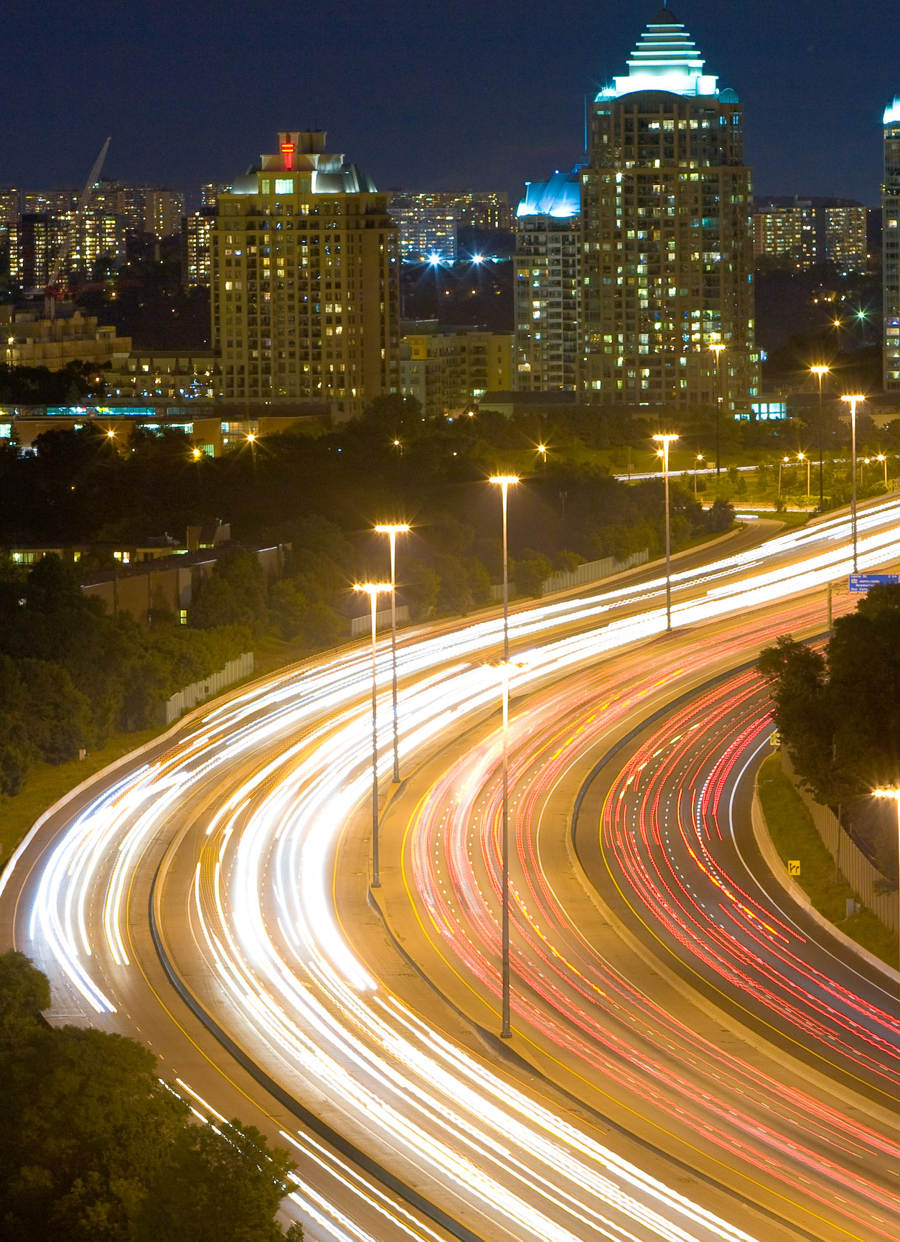
Introduction
Transportation is an essential part of modern life, connecting people and goods across the globe. Whether it's commuting to work, traveling for leisure, or transporting goods for business, our reliance on various modes of transportation is undeniable. However, along with the convenience and efficiency that transportation offers, there comes a critical concern—road safety.
Road safety is a matter of paramount importance, as accidents on the road can lead to loss of life, injuries, and significant economic costs. Every year, millions of people are affected by road accidents worldwide. Therefore, it is crucial to prioritize and promote road safety in all aspects of transportation, from designing safer roads and vehicles to adopting responsible driving behaviors and utilizing advanced technologies.

Slide 3

The number of fatal and disabling road accident happening is increasing day by day and is a real public health challenge for all the concerned agencies to prevent it. Some of the main causes of these accidents are :
Distracted driving
Impaired driving
Poor road conditions
Over speeding
Disobeying traffic signals
Over speeding is one of the key reasons on a global scale. The World Health Organisation (WHO) estimates that excessive speed is a factor in up to half of all road traffic fatalities in low- and middle-income countries and accounts for about one-third of all fatalities in high-income nations. These data highlight the extent of the issue and the pressing need to solve it.
This Photo by Unknown author is licensed under CC BY-ND.

Slide 4

We have frequently observed drivers breaking traffic laws, such as disregarding signboards, speed restrictions, and other traffic regulations. Accidents occur as a result.
Let's say we are travelling at 70 km/h on a poor road, but we are not aware of this and we have not observed the speed restriction sign i.e. 30 km/h. As a result of that, we crashed our car. The reason why there are so many accidents every day worldwide is ignorance of mind.

Slide 5

Our Ideas for Resolving this Problem
Our idea is that we may put a scan code at the beginning of roads that are prone to accidents or are in poor condition, and the vehicle will scan it and automatically reduce the vehicle speed to the speed limit.
How will it works ?
We'll create a scan code with information about the speed restrictions based on the state of the roads. On the speed limit or sign boards, we can post this scan code. Then, a software that uses the camera to decipher the scan code must be installed in the cars. Once the code has been successfully decoded, Adaptive Cruise Control (ACC) will automatically reduce the speed, lowering the risk of an accident.

Slide 6

Thank you

